Slide 1
Geosemantics: Text Mining and Linked Data at the British Geological Survey
Jo Walsh – Senior Software Engineer, British Geological Survey
jowalsh@bgs.ac.uk

Slide 2
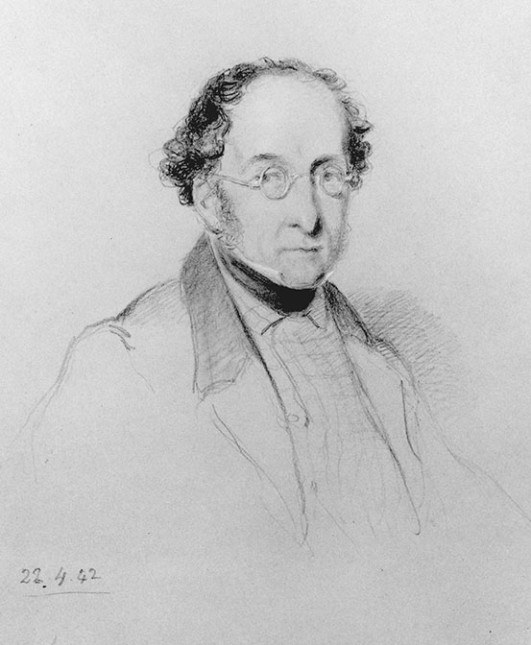
British Geological Survey (BGS)
The British Survey can claim to be the oldest such undertaking to have functioned continuously since its inception in May 1832 and formal establishment on 11 July 1835.
Sir Henry Thomas De la Beche, by William Brockedon, 1842 (© National Portrait Gallery, London).

Slide 3
Geosemantics
Natural Language Processing with open source tools
Named Entity Recognition model from labelled text
Linked Open Data vocabularies for BGS resources
Classifying relations between Named Entities

Slide 4
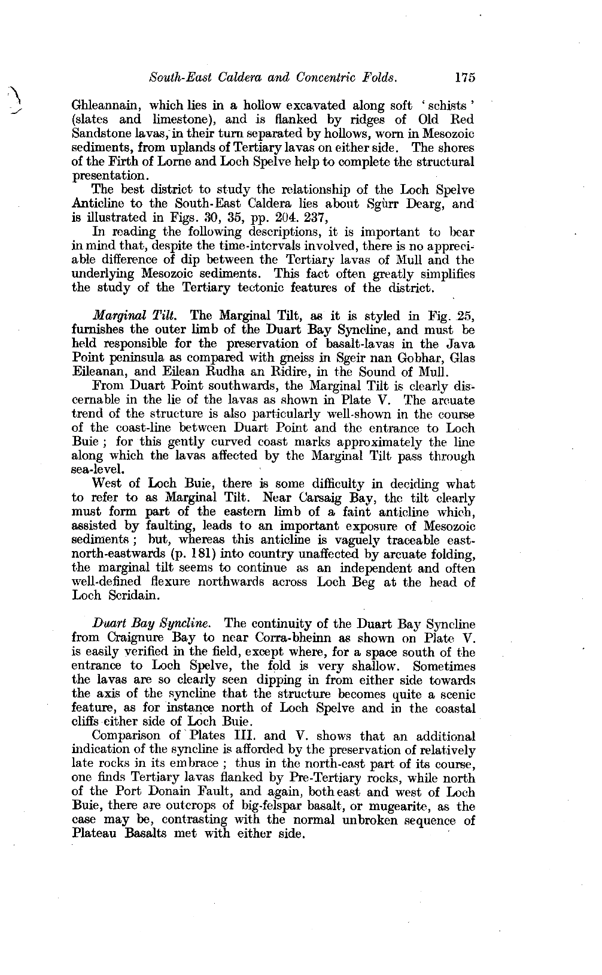
Geological Memoirs
The memoirs, compiled by BGS geologists, date from the late 1890s to present day and provide a comprehensive and detailed account of all aspects of the geology of an area.

Slide 5
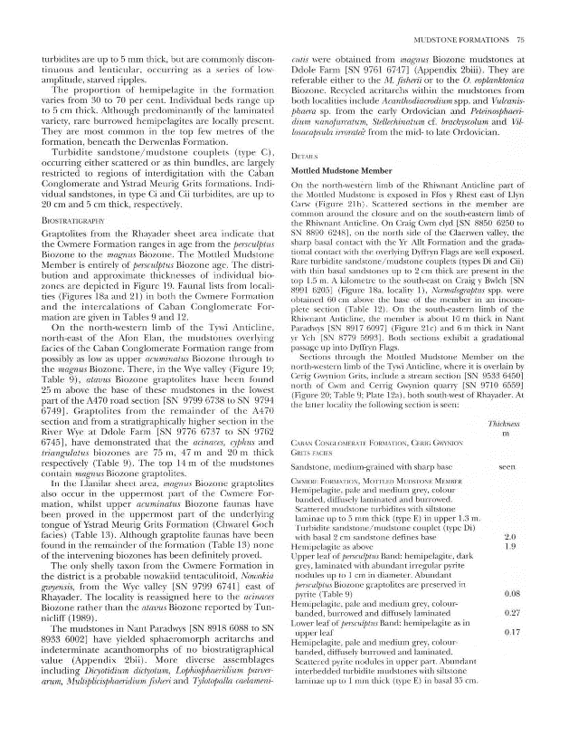
Geological memoirs
Scanned texts processed with optical character recognition software have been corrected by hand and annotated with identifiers for other BGS data (borehole logs, core samples)

Slide 6
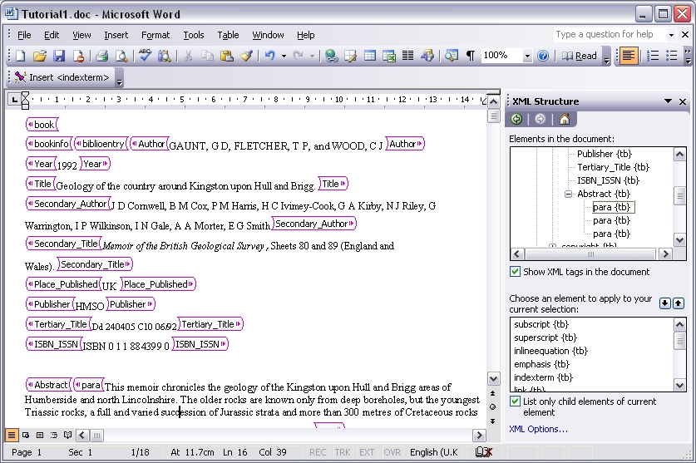
Textbase 2000
In the early 2000s, BGS ran a small project converting 30 regional reports including memoirs into XML using Word

Slide 7
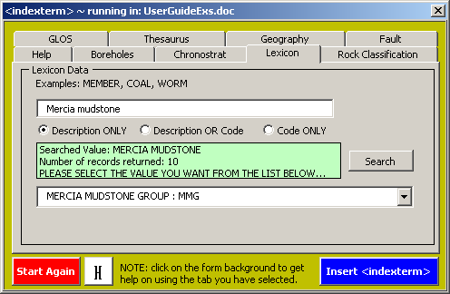
Textbase 2000
This earlier project added not just syntactic information about the layout of the document, but also some semantic information, labelling words and phrases and linking them to BGS controlled vocabularies

Slide 8
Textbase 2000
From these manually-created annotations we extracted 2500 sentences
Every term found in the BGS Lexicon of Named Rock units is labelled LEXICON
Every reference to a geochronological or chronostratigraphic term is labelled CHRONOSTRAT
We used this data to train a custom Named Entity Recognition model

Slide 9
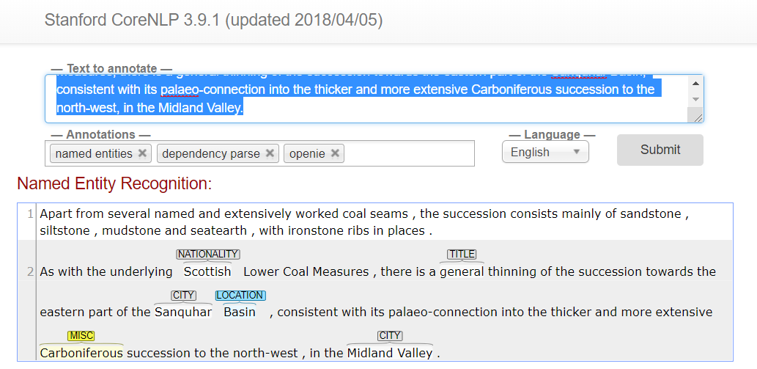
Stanford CoreNLP NER
Basic output w/o our vocabularies added
Named Entity Recognition (NER) with default CoreNLP

Slide 10
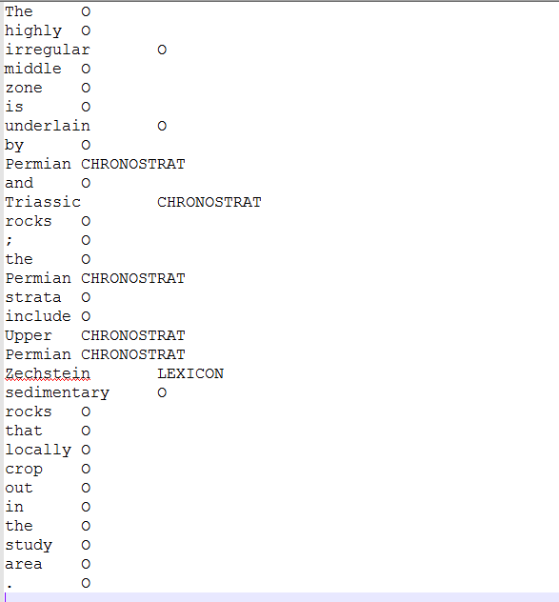
CoreNLP training data - sample

Slide 11
Train NER model with CRFClassifier
java -cp stanford-ner.jar edu.stanford.nlp.ie.crf.CRFClassifier -prop bgs.3class.geo.prop
https://nlp.stanford.edu/software/crf-faq.shtml

Slide 12
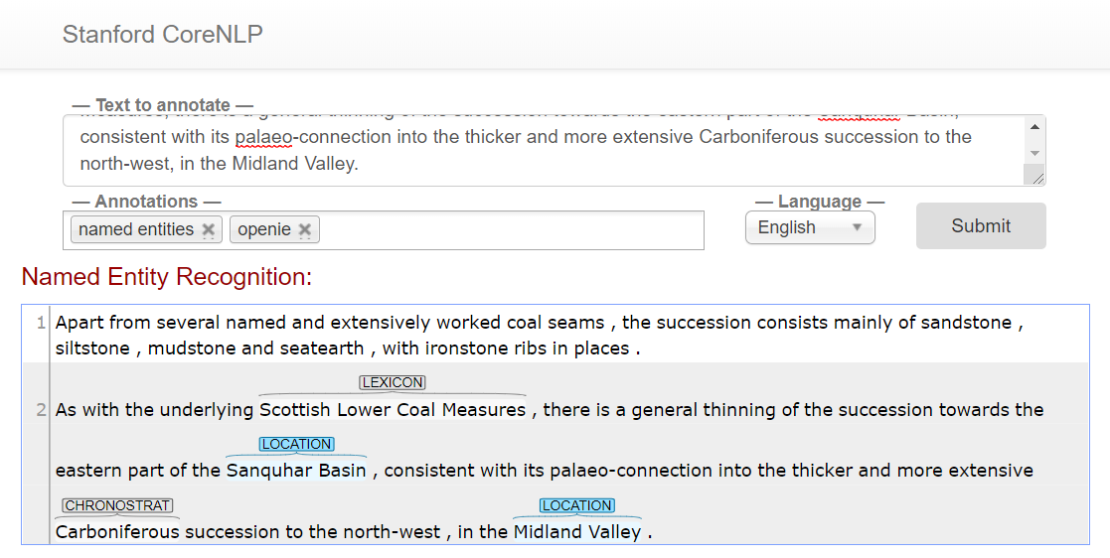
Custom NER for CoreNLP
Named entities recognised with custom model added

Slide 13
Adding additional vocabularies
Given enough labelled examples, train a Named Entity Recognition model with a different vocabulary
We had a few BIOZONEs in our training data but too few examples for the classifier to learn from

Slide 14
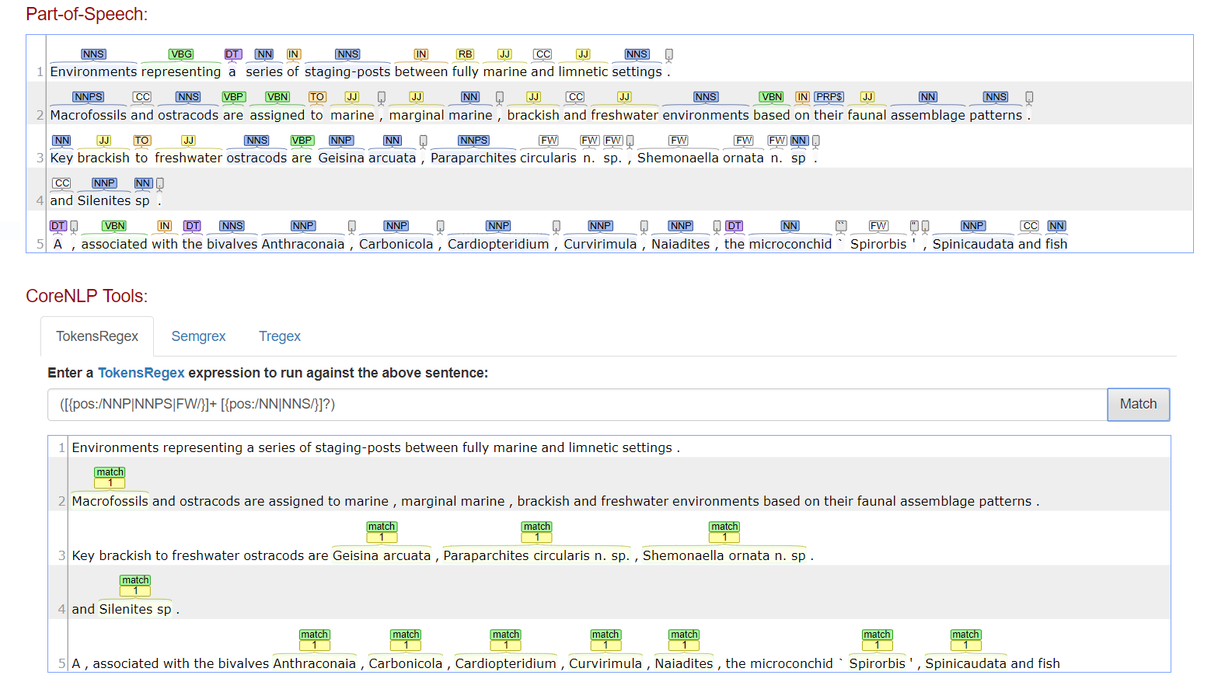
Rule-based approach using parts of speech
TokenRegex

Slide 15
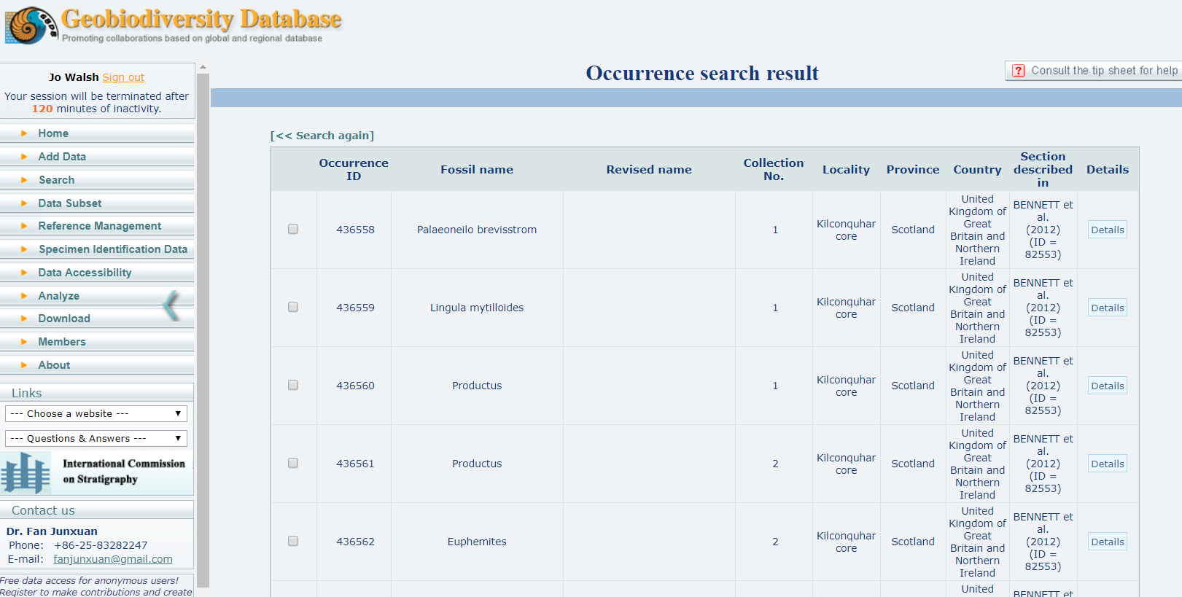
Or use manually extracted entities to recreate labelled sentences

Slide 16
Alternatives to CoreNLP
spacy.io is a python-based toolkit for Natural Language Processing
Nicer for integration with other python tools for machine learning and scientific computing
We tried re-training spacy’s NER with BGS data but couldn’t get it to the same result quality
USGS have used spacy to recognise dams and rivers in their dam removal project

Slide 17
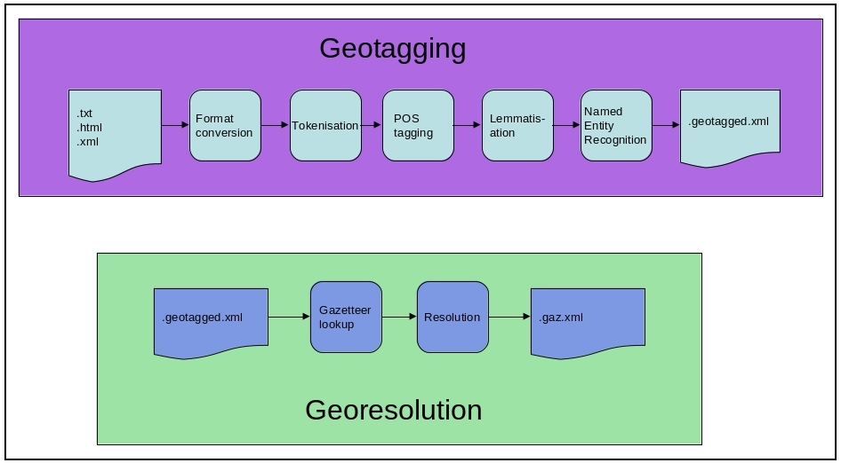
Alternatives to CoreNLP
Edinburgh Geoparser from Language Technology Group, School of Informatics, University of Edinburgh
Uses a rule-based approach rather than a statistical model
We used its “georesolution” phase to find coordinates for locations

Slide 18
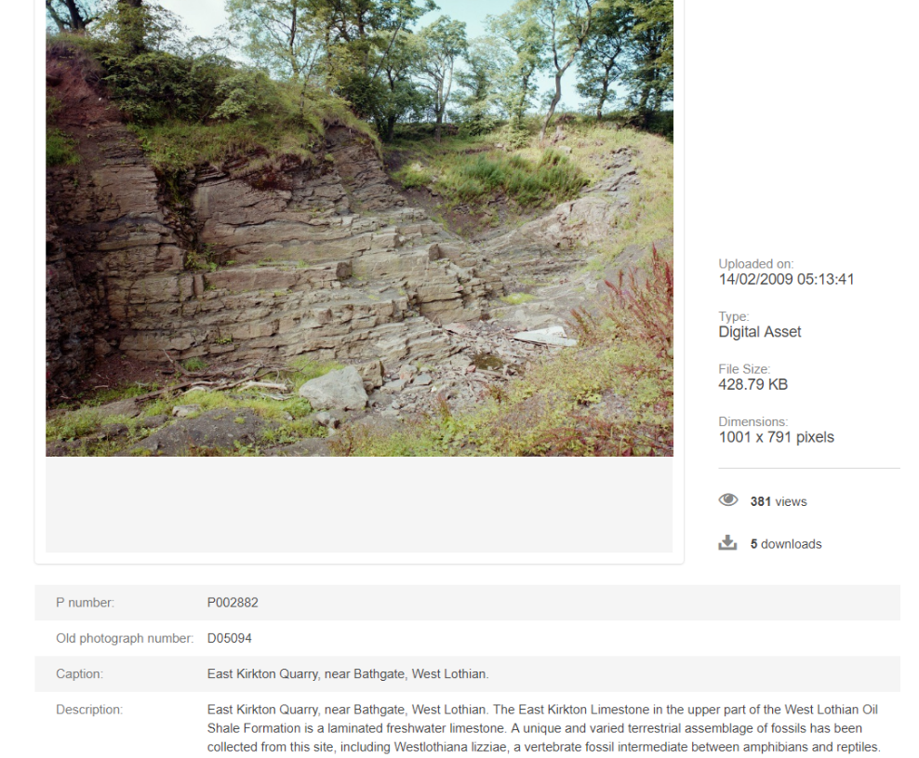
Image captions derived from sheet memoirs

Slide 19
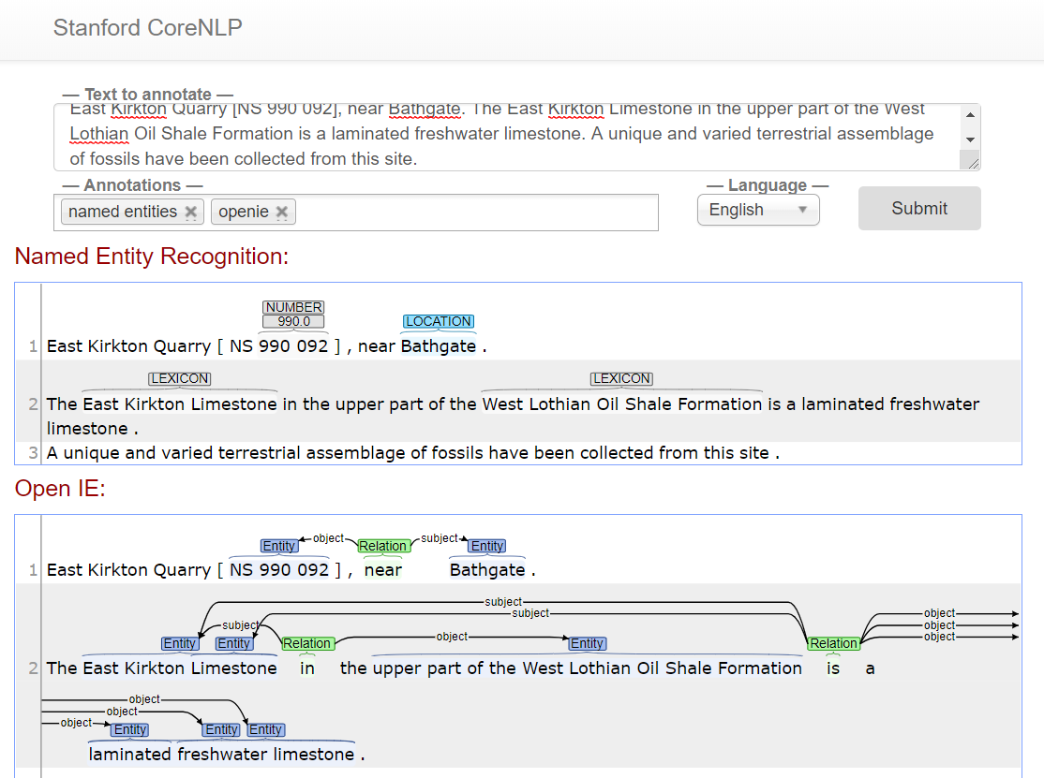
Entities found with CoreNLP

Slide 20
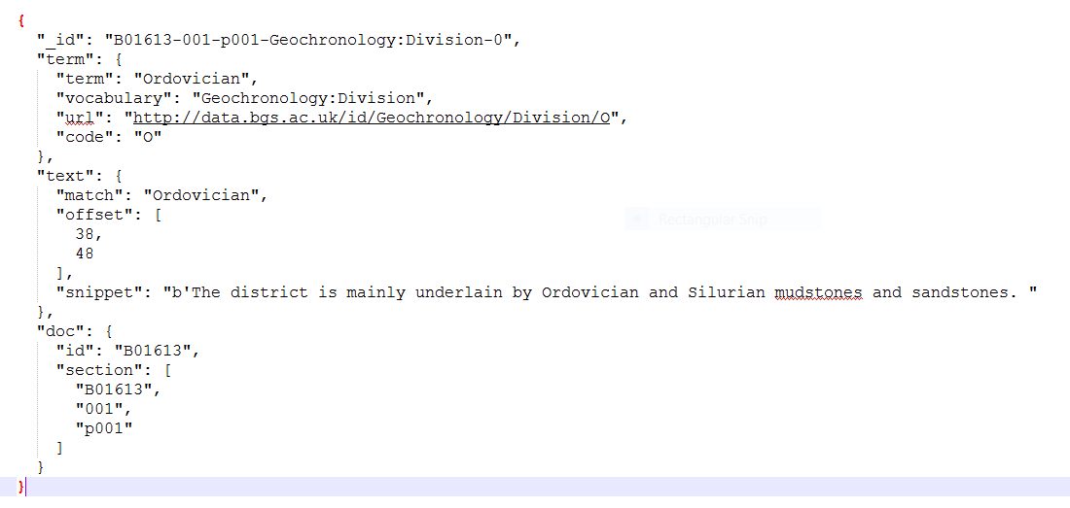
Links to BGS vocabularies
JSON documents stored in and queried from a MongoDB document store

Slide 21
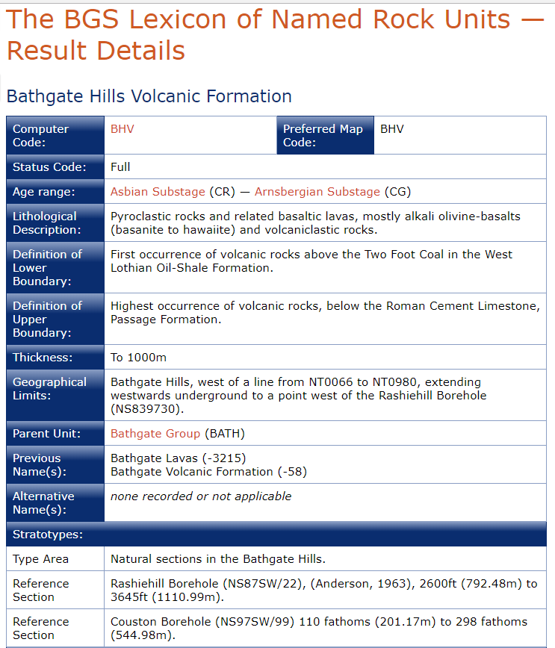
Lexicon of Named Rock Units
Web-based
Human-readable

Slide 22
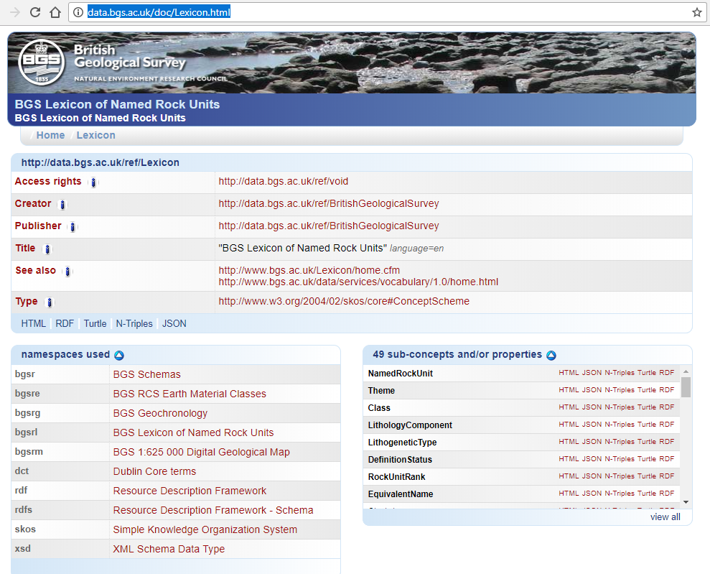
Linked Data Lexicon
Web-based
Machine-
readable

Slide 23
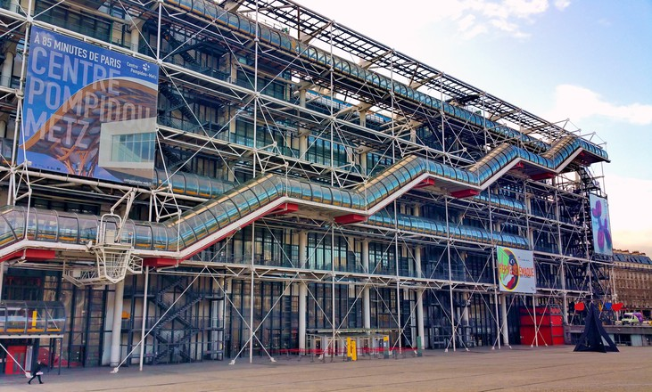
“Pompidou Centre” data
A phrase coined by Peter Burnhill of EDINA, University of Edinburgh
Data infrastructure is exposed on outside of the structure
Photo credit: copyright Pascal Poggi

Slide 24
“Use URIs as names for things”
Internal code: CAL
External code: http://data.bgs.ac.uk/id/Lexicon/RockUnit/CAL
lexicon:CAL
chronology:CG
lexicon:hasYoungestAge

Slide 25
Link to other things on the semantic web
http://data.bgs.ac.uk/id/Geochronology/Division/C
owl:sameAs
http://resource.geosciml.org/classifier/ics/ischart/C
owl:sameAs
http://dbpedia.org/page/Carboniferous

Slide 26
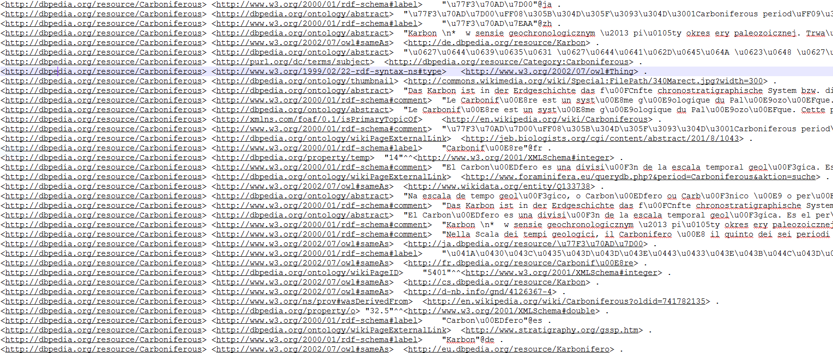
Triples all the way down

Slide 27
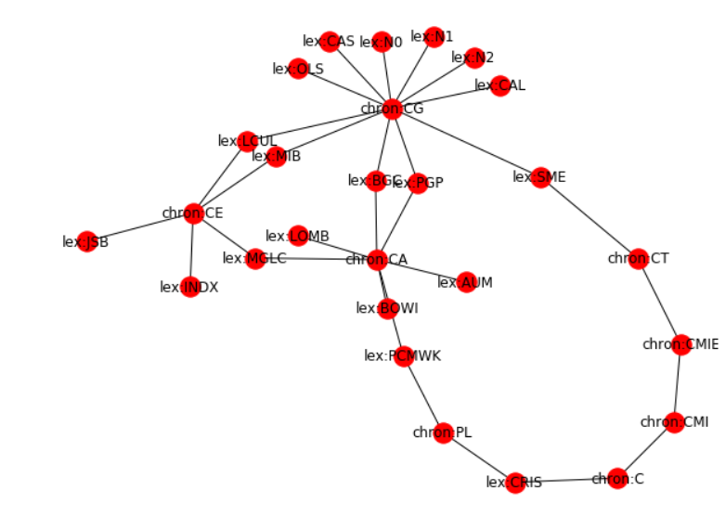
Knowledge Graph
Fashionable term for linked data extracted from text
Named entities extracted from a BGS
Palaeontology report
Sum of all shortest paths through
a graph of connections between
min/max ages of rock types
and ICS hierarchy of
geochronological eras
rdflib, networkx, matplotlib

Slide 28
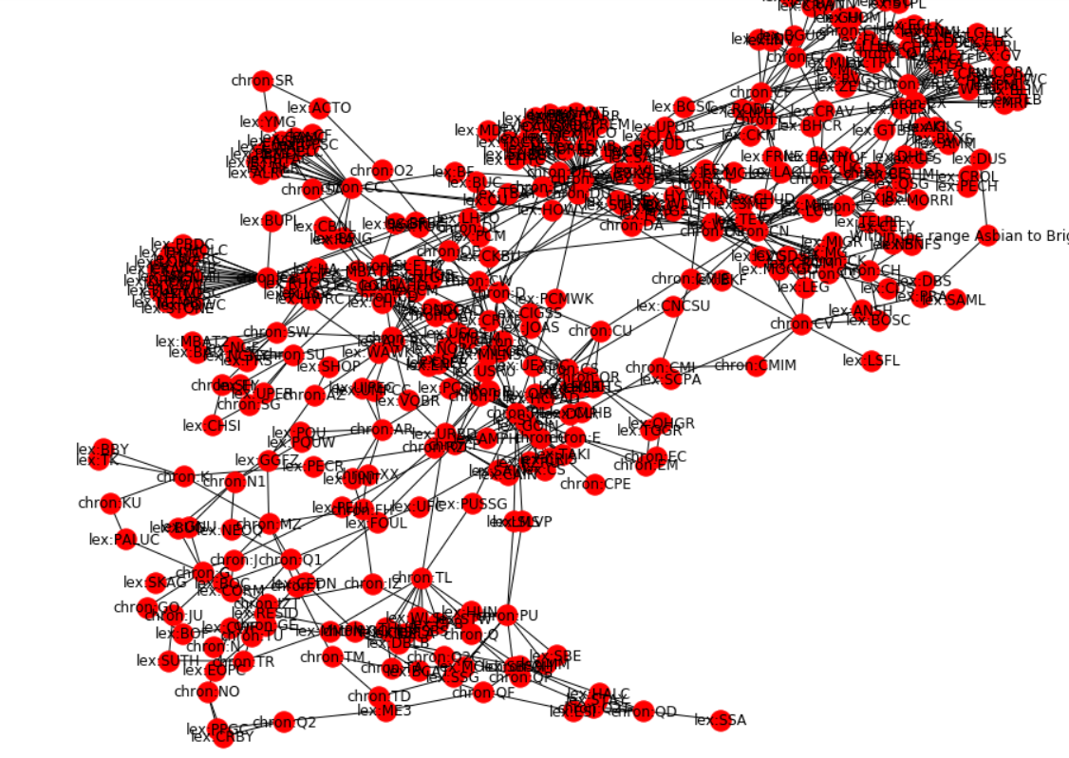
Is this knowledge?
Same process;
Graph inferred from
several hundred page
map sheet memoir

Slide 29
Links to other resources
Other kinds of BGS data resources are already linked to the Lexicon and Geochronology
Thin section imagery, borehole scans
Deposited datasets have some manually-added tags
We can automatically add more to new incoming data
Also a lot of un-mined text content in the Lexicon itself

Slide 30
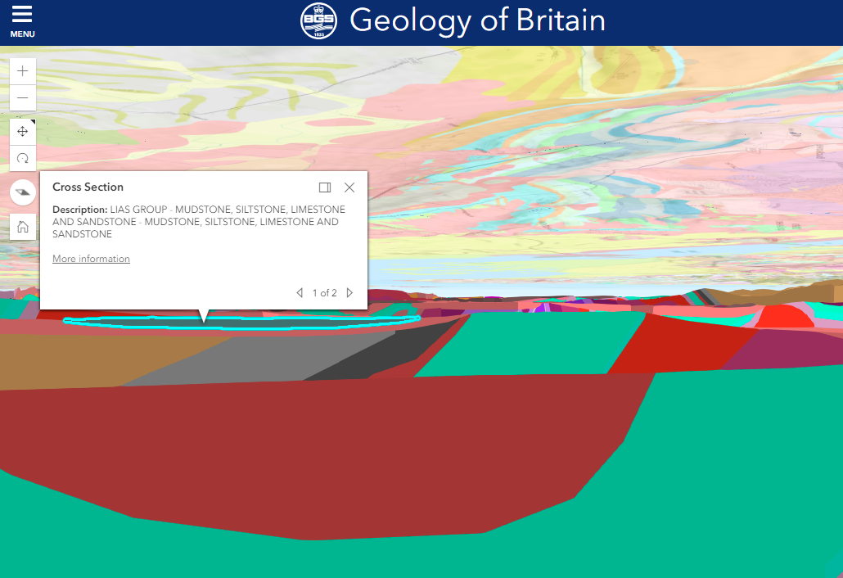
Other linked resources
BGS 3D geological models are linked to the rock units

Slide 31
BGS memoirs – entities visualised
We ran the Named Entity Recognition over 60 BGS memoirs in cleaned-up XML format
We extracted references to Chronostratigraphic terms, to Lexicon of Named Rock Units, and locations
We also ran a selection of PDF scans of palaeontology reports
Even with lower-quality OCR the results are promising

Slide 32
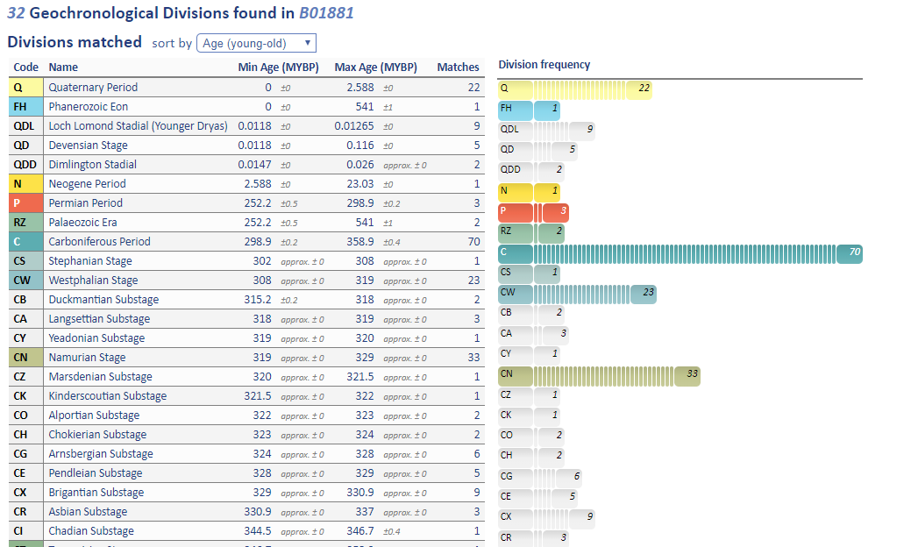
Geochronology extracted from text

Slide 33
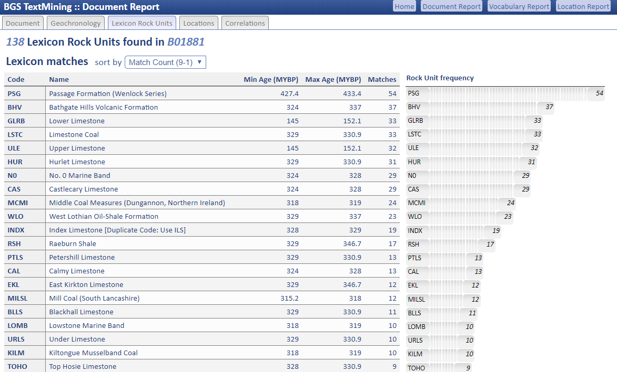
Mentions of rock unit types

Slide 34
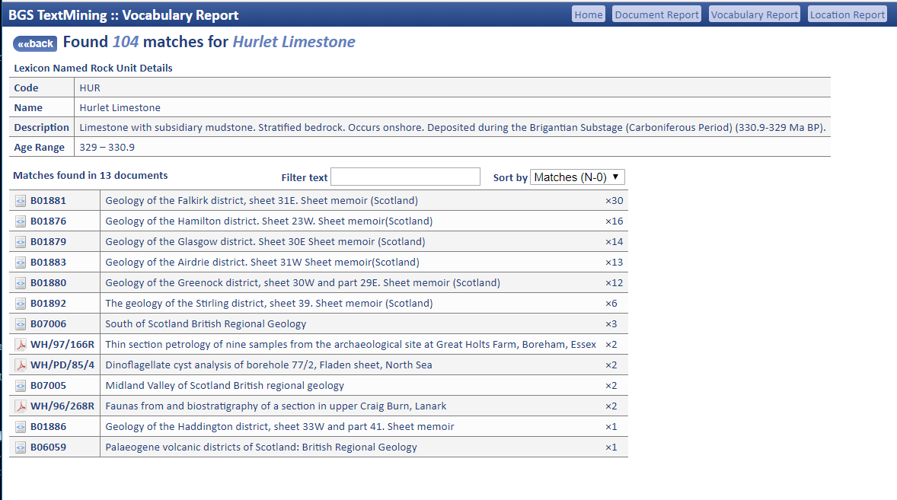
Rock unit types across documents

Slide 35
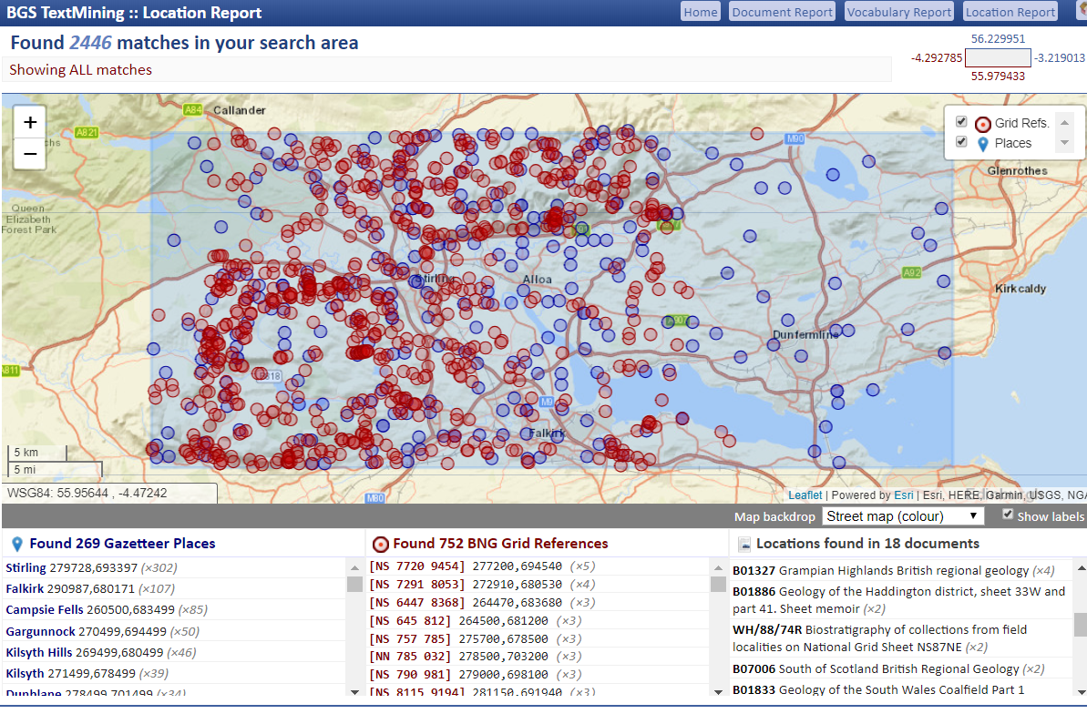
Memoir overview

Slide 36
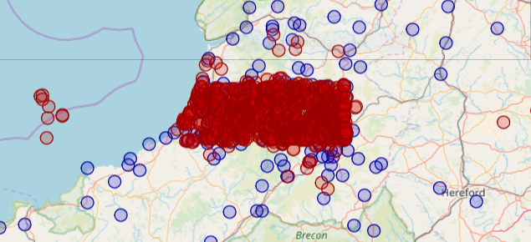
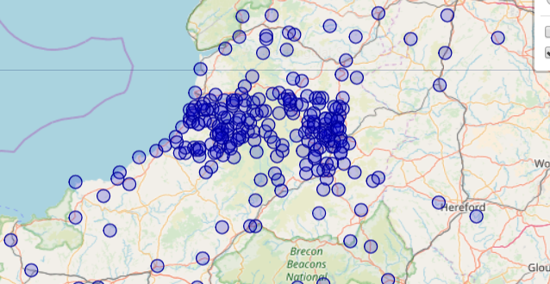
Explore references to places
Coordinates found in text:
Place-names
recognised in text:

Slide 37
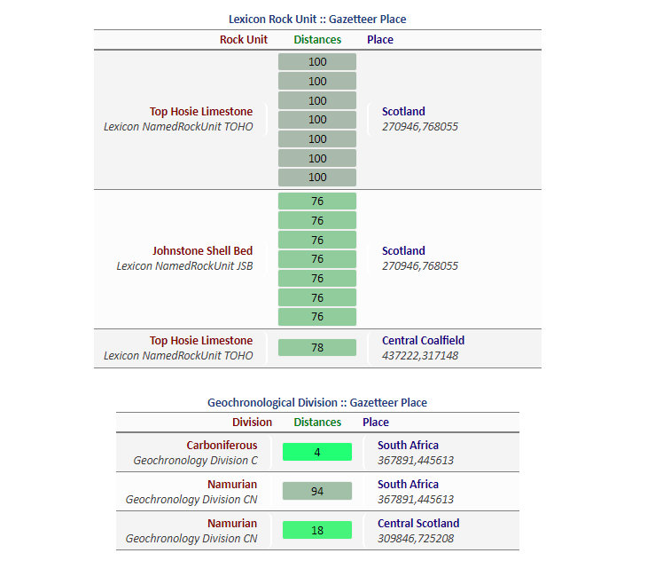
Correlations between entities

Slide 38
Next annotation task
We can see co-occurrences of terms but want to know when they are most meaningful
We want a model classify positive and negative correlations between named entities in sentences
Natural History Museum in Oslo have done a similar project with excellent results
Resulting in the ability to infer fossil ages from correlations of taxa with chronostratigraphic names

Slide 39
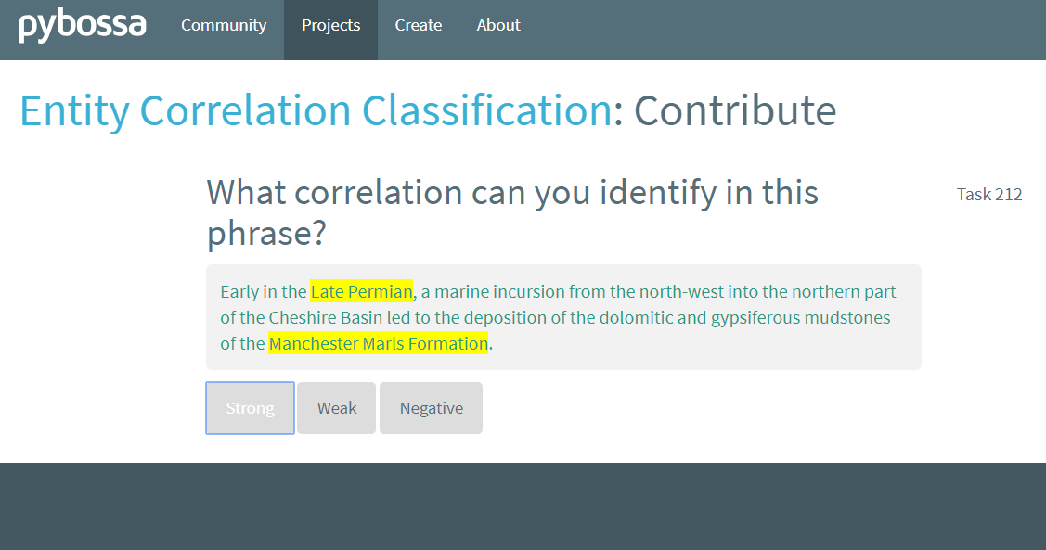
pybossa task to classify relations
pybossa.org - like an open source GalaxyZoo
We will need several annotators to label
several thousand sentences for a decent model

Slide 40
Training a TextCategorizer
NHM in Oslo built with own classification model
Feeding skipgram word embeddings from fasttext into an LSTM created with scikit-learn
We are planning to start with the TextCategorizer package in spacy.io and work from there

Slide 41
Extracting tables and figures
GeoDeepDive is a project at University of Madison, Wisconsin, US
GeoDeepDive searches mainly journal publications but holds some geological survey archives
With Stanford CoreNLP with Tesseract OCR they scan and analyse millions of short publications
Blackstack is a new component of the GeoDeepDive project which takes a machine learning approach to identifying figures, maps and tables
It’s a work in progress!
https://geodeepdive.org
https://github.com/UW-Deepdive-Infrastructure/blackstack

Slide 42
Conclusions
“You have to have a human in the loop; what matters is where you put the human in the loop”
Claire Grover, Language Technology Group, University of Edinburgh
NER tools are accessible without NLP expertise
Semantic web is reviving with a simpler approach
Potential to generate scientific discoveries…
… but are we often discovering the obvious?
Geosemantics at BGS Informatics
Project leader: Rachel Heaven: reh@bgs.ac.uk
PhD student: Ike Nkisi-Orji: i.o.nkisi-orji@rgu.ac.uk

